Slide 1
The Hartford Evaluates Oracle Exadata
Presentation to Oracle OpenWorld 2009 Conference
Peter Osborne, Director – The Hartford
James Madison, Enterprise Architect – The Hartford
Murali Dhanavelu, Director – TCS
Satyendra Vyas, Enterprise Architect – TCS

Slide 2
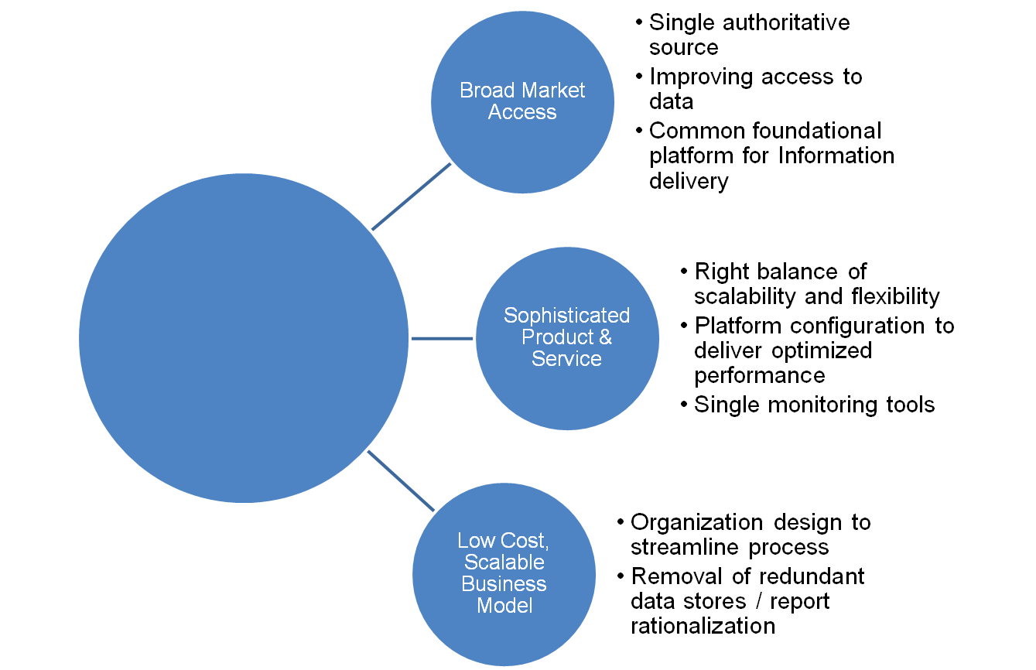
The Program objective is to deliver fast, cost-effective access to accurate information aligning to the Business Service Vision
Constantly Improve Value to Customers
Remove Constraints to Profitable Growth
- <number> -

Slide 3



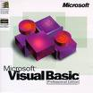



Where we were….
Opportunity to:
  Reduce operational costs
  Remove “Data Silos” and “duplication” spread across variety of platforms
  Simplify process & infrastructure
  Improve performance for analytics
LoB 1
LoB 2
LoB 3
..
Text files
Data Sources
ETL
Database Platform
Data Delivery
- <number> -

Slide 4

Where we want to be….
Reduce TCO by 10% annually
Reduce complexity & enforce “Manufacturing Mindset”
Support high performance analytics enabling slicing and dicing of the data
Improve turn around time for data manufacturing and data delivery
One ETL Tool
Report Rationalization
LoB1
LoB2
LoB3
Data Sources
ETL
Database Platform
Data Delivery
- <number> -

Slide 5







How we approached this evaluation process
Planning
Stakeholders identified
User survey to capture current pains points
Snapshot of current and future requirements for platform
Develop evaluation
Framework
Scoring framework using Balanced Score Card (BSC) identified
Five dimensions on evaluation criteria decided upon
Initiate Platform
RFI Process
Industry scan for EDW vendors
Circulated RFI to short-listed vendors
Vendor demos and RFI scoring done
Perform TCO
Analysis
Technical metrics compared
Cost details from vendors obtained
TCO, Migration compared
Migration
Approach & Estimates
Migration complexity analysis
Migration cost
Plan and Conduct
PoCs
Criteria, applications for PoC
Setup PoC platforms and prepare data
Run PoC cycles and capture results
Measure size, power consumptions etc
Rank &
Recommend
Share scoring results
Recommended platform
- <number> -

Slide 6
Balanced Score Card (BSC) Framework
  Conventional methods failed to establish a solid baseline for scoring, as they are driven by platform features without considering “The Hartford” realities
  BSC helped to incorporate measurements in the process under each of the decision parameters
  Critical success factors from the organization perspective such as processes, infrastructure leverage, skills availability across support groups, etc. were given appropriate weight
  Universal Level Agreement (ULA) considered as a critical deciding factor for platform costs
Parameter | Vendor 1 | Vendor 2 | Vendor 3
Price Performance
Technical Merits
Platform Costs
Migration Costs
Ease of doing Business
- <number> -

Slide 7
RFI Evaluation score card – Top Ten Decision Criteria
  61 decision factors were considered in the Balanced Score Card
  Team voted to come up with top nine decision factors out of 61
Decision Factor | Weights Assigned
Performance | 18
Administration | 12
Business Capabilities | 7
Operational Efficiency | 4
Vendor Maturity | 4
Availability | 3
Migration | 3
Future Roadmap | 1
Tool Suites | 1
- <number> -

Slide 8
Real business queries and ETL Load captured for PoC
Dollars per query hour
The performance was improved 400 times faster than the current performance times
2-3 TB of data chosen and was doubled for scalability testing
ETL and reporting queries were executed concurrently and serially
66 queries from production were used to measure 2-3 TB of data for both ETL and reporting process
- <number> -

Slide 9
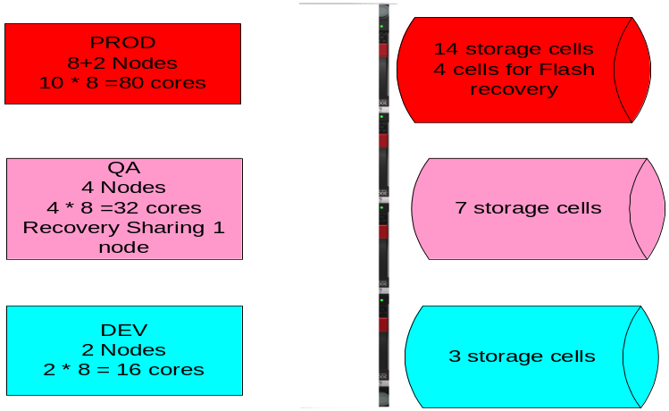
Where we are now
  Completed building development environment, QA and production build is in progress
  Migration to Exadata Platform for one of three LoBs is underway
  Laid out the plan for Re-platforming Teradata to Exadata
  Strategy to retire redundant data stores
Exadata Platform
One ETL Tool
Report Rationalization
Common Data Base Platform
Data Sources
ETL
Database Platform
Data Delivery
- <number> -

Slide 10
Where we are heading…
Completing the set up for production ready enterprise warehouse platform
Complete re-platforming of the existing warehouse environments
Migrating all LoBs over to Exadata
Retiring all existing servers that are in non-Exadata platform
- <number> -
- <number> -

Slide 11
Thank You

